Slide 1

The prisoners of hack-a-ton
Presented by:
Lucas De Naegel & Lander Reynvoet

Slide 2

WHAT WE DID

Slide 3
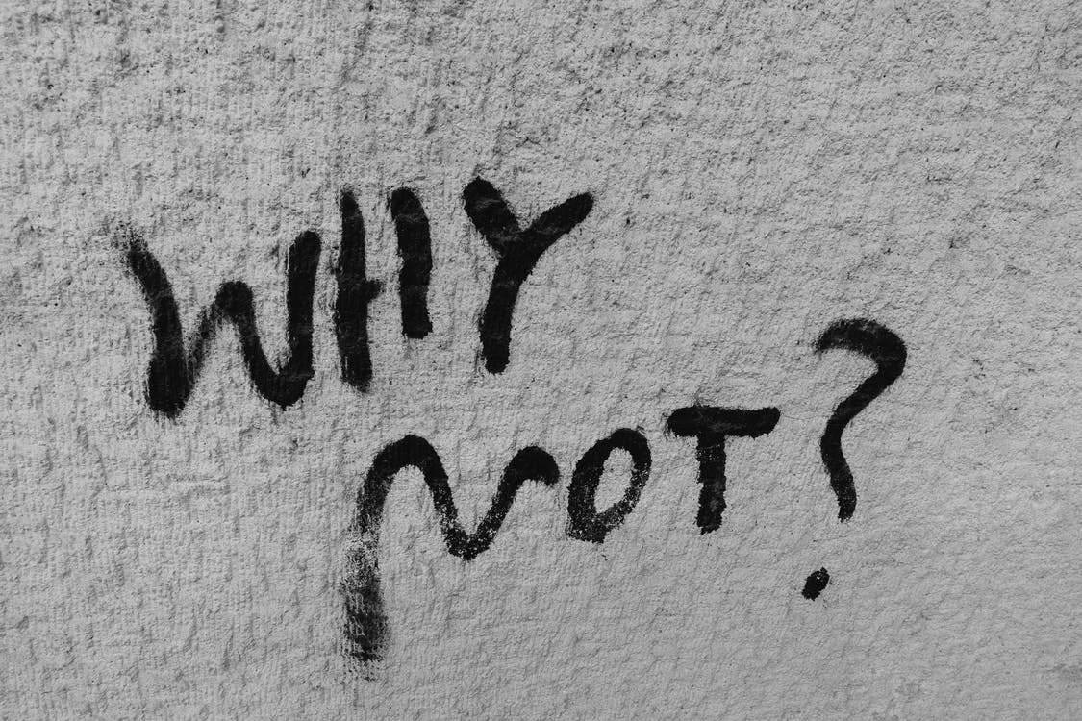
WHY WE DID IT

Slide 4
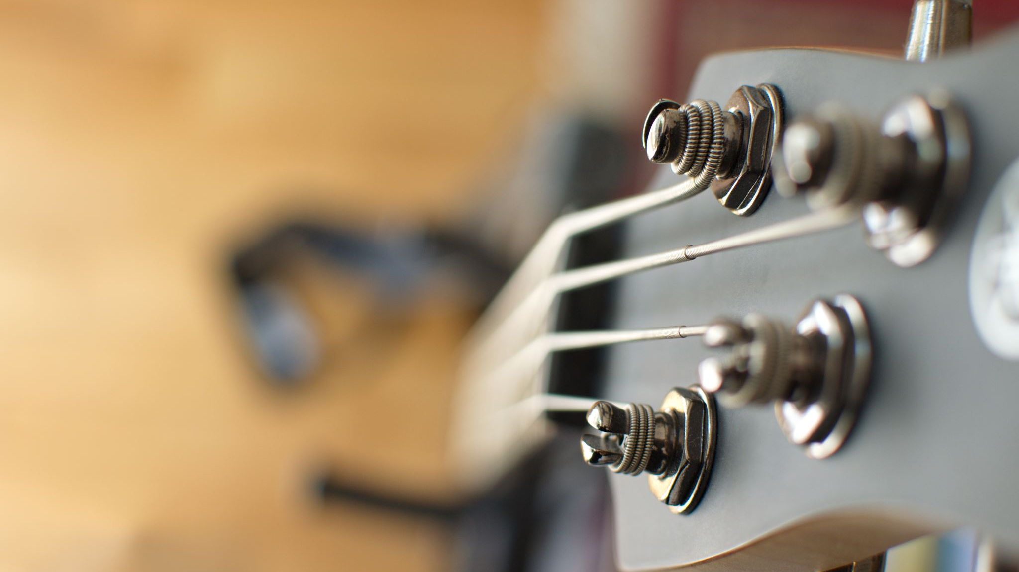
DEMO

